Slide 1
PHP Application with MySQL
ITWA133

Slide 2
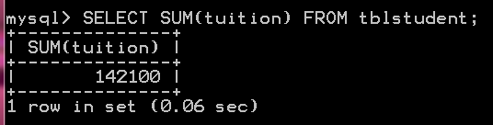
Using Group Functions
Example: SUM
$query = mysql_query(“SELECT SUM(tuition) FROM tblstudent”);
$fetch = mysql_fetch_array($query)
echo $fetch[“SUM(tuition)”]

Slide 3
Using Group Function
$query = mysql_query(“SELECT SUM(tuition) FROM tblstudent”);
$fetch = mysql_fetch_array($query)
echo $fetch[0]

Slide 4
Using Group Function
$query = mysql_query(“SELECT SUM(tuition) FROM tblstudent”);
$fetch = mysql_result($query,0);
echo $fetch;

Slide 5
mysql_result()
mysql_result() retrieves the contents of one cell from a MySQL result set
Syntax:
mysql_result($result_query, row, field)
$result_query - The result resource that is being evaluated. This result comes from a call to mysql_query().
row - The row number from the result that's being retrieved. Row numbers start at 0.
field - The name or offset of the field being retrieved.

Slide 6
Example: mysql_result()
$query = mysql_query(“SELECT name FROM tblstudent”);
$fetch = mysql_result($query, 2) //gets the 3rd row of name
echo $fetch; // prints the 3rd row of name
$query = mysql_query(“SELECT CONCAT(name,’ ‘,gender) as Output FROM tblstudent WHERE id=‘200812345’”);
$fetch = mysql_result($query, 0, “Output”)
echo $fetch; // prints the name & gender of the query

Slide 7
Using Group Functions
Example: MAX
$query = mysql_query(“SELECT MAX(tuition) FROM tblstudent”);
$fetch = mysql_fetch_array($query)
echo $fetch[“MAX(tuition)”]
$query = mysql_query(“SELECT MAX(tuition) FROM tblstudent”);
$fetch = mysql_fetch_array($query)
echo $fetch[0]
$query = mysql_query(“SELECT MAX(tuition) FROM tblstudent”);
$fetch = mysql_result($query,0);
echo $fetch;

Slide 8
Using Group Functions
Example: MIN
$query = mysql_query(“SELECT MIN(tuition) FROM tblstudent”);
$fetch = mysql_fetch_array($query)
echo $fetch[“MIN(tuition)”]
$query = mysql_query(“SELECT MIN(tuition) FROM tblstudent”);
$fetch = mysql_fetch_array($query)
echo $fetch[0]
$query = mysql_query(“SELECT MIN(tuition) FROM tblstudent”);
$fetch = mysql_result($query,0);
echo $fetch;

Slide 9
mysql_affected_rows()
mysql_affected_rows() get the number of affected rows by the last SELECT, INSERT, UPDATE, REPLACE or DELETE query.
Syntax: mysql_affected_rows()
Example:
$query = mysql_query(“SELECT id FROM tblstudent WHERE id LIKE ‘%2009%’”);
echo mysql_affected_rows(); // will return the number of rows
matched from the query

Slide 10
mysql_num_rows()
mysql_num_rows() retrieves the number of rows from a result set. This command is only valid for statements like SELECT or SHOW that return an actual result set.
Syntax: mysql_num_rows()
Example:
$query = mysql_query(“SELECT id FROM tblstudent WHERE id LIKE ‘%2009%’”);
echo mysql_num_rows(); // will return the number of rows
matched from the query

Slide 11
More MySQL Functions
Visit
http://www.php.net/manual/en/ref.mysql.php
http://w3schools.com/php/php_ref_mysql.asp

Slide 12
Working with File Uploads

Slide 13
$_FILES
Using the global PHP $_FILES array you can upload files from a client computer to the remote server.
Syntax: $_FILES[“file”][“index”]
file – the name of the field in the form
index – specifies the parameter to be processed by $_FILES
Index | Description
name | The name of the uploaded file
type | The type of the uploaded file
size | The size of the uploaded file
tmp_name | The name of the temporary copy of the file stored on the server
error | the error code resulting from the file upload

Slide 14
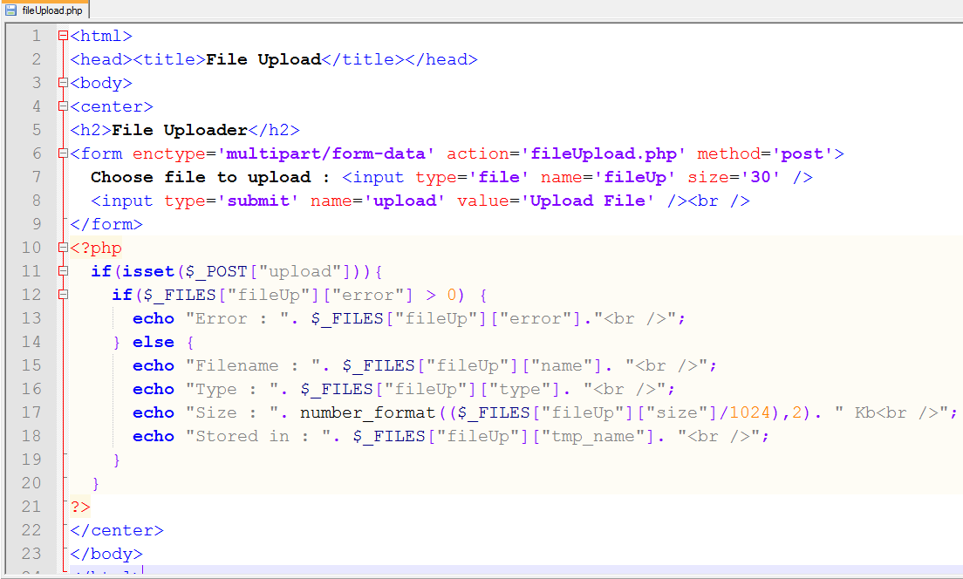
Create the upload form

Slide 15
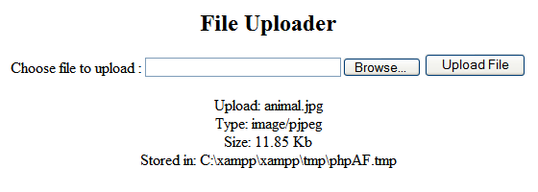
Sample Output

Slide 16
Saving File Permanently
To save permanently the uploaded file, use the move_uploaded_file() function. This function returns TRUE on success, or FALSE on failure.
Syntax: move_upload_file(file, new location);
Example:
$destination = ‘uploadedFile’; // folder in your htdocs
$tmp_name = $_FILES[“fileUp”][“tmp_name”];
$filename = $_FILES[“fileUp”][“name”];
move_uploaded_file($tmp_name, “$destination/$filename”);

Slide 17
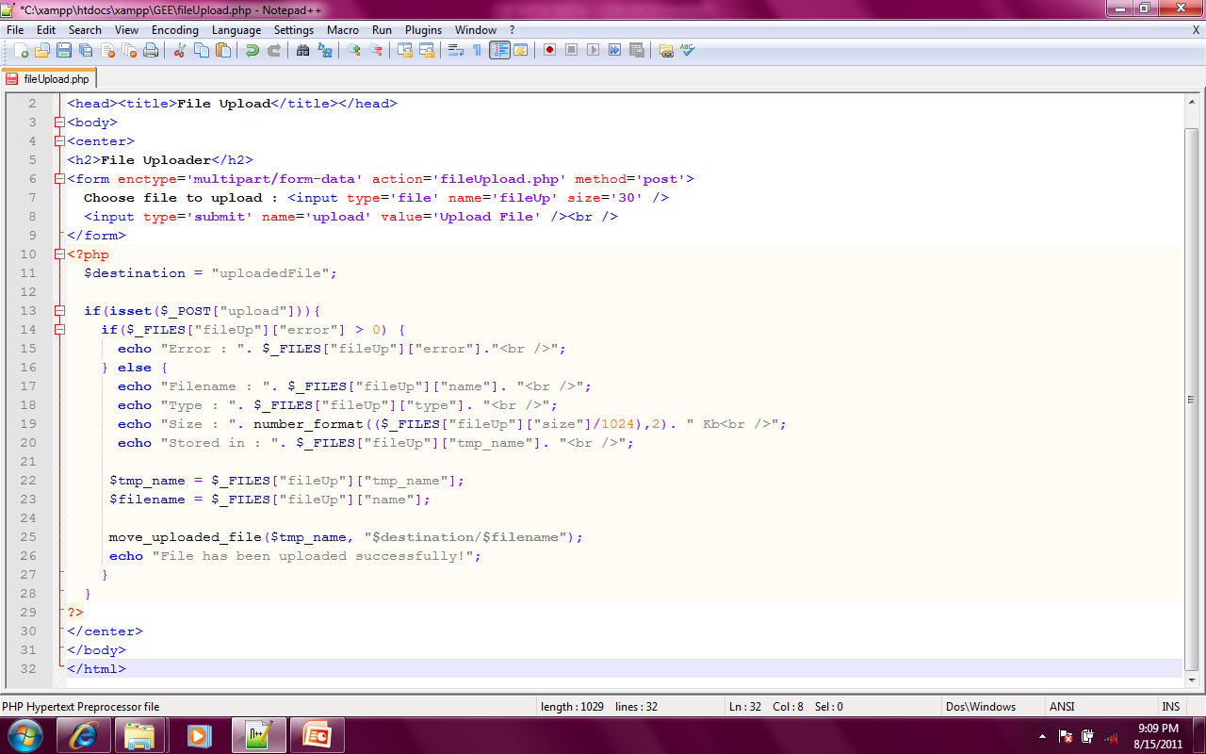
Example

Slide 18
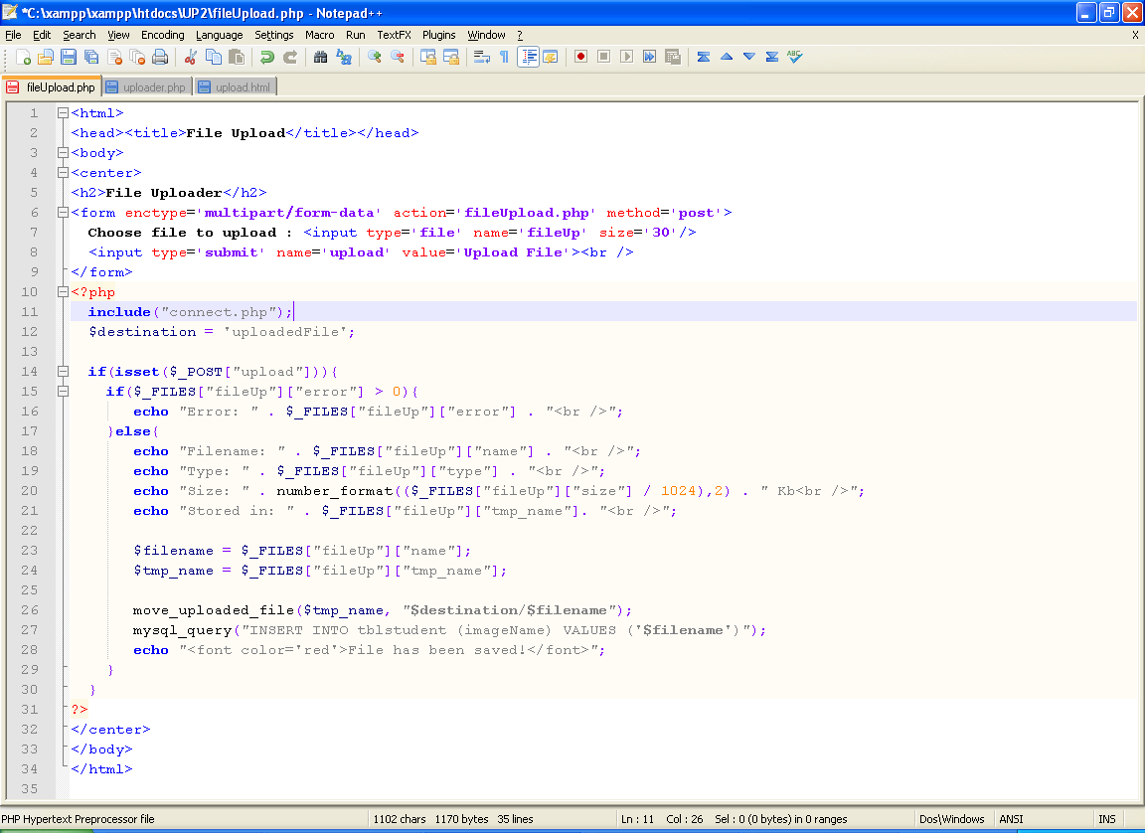
Example

Slide 19
Validating Files
Function | Description | Example
file_exists() | Checking for file existence | file_exists(“test.txt”)
is_file() | Checking if it is a file | is_file(“test.txt”)
is_dir() | Checking if it is a directory | is_dir(“/tmp”)
is_readable() | Checking the file status | is_readable(“test.txt”)
is_writable() |  | is_writable(“test.txt”)
is_executable() |  | is_executable(“test.txt”)
filesize() | Determining file size | filesize(“test.txt”)

Slide 20
Example
<?php
$file = "test.txt";
outputFileTestInfo($file);
function outputFileTestInfo($f) {
if (!file_exists($f)) {
echo "<p>$f does not exist</p>";
return;
}
echo "<p>$f is ".(is_file($f)?"":"not ")."a file</p>";
echo "<p>$f is ".(is_dir($f)?"":"not ")."a directory</p>";
echo "<p>$f is ".(is_readable($f)?"":"not ")."readable</p>";
echo "<p>$f is ".(is_writable($f)?"":"not ")."writable</p>";
echo "<p>$f is ".(is_executable($f)?"":"not ")."executable</p>";
echo "<p>$f is ".(filesize($f))." bytes</p>";
}
?>

Slide 21
Creating and Deleting Files
touch() - attempts to create an empty file. If the file already exists, its contents won't be disturbed, but the modification date will be updated to reflect the time at which the function executed.
Example: touch(“myfile.txt”);
unlink() – a function used to remove an existing file.
Example: unlink(“myfile.txt”);

Slide 22
Opening a File for Writing, Reading, or Appending
fopen() – is used to open a file for reading, writing or appending content
Syntax: fopen(“file”, “mode”);
Example:
fopen(“test.txt”, “r”) – for reading
fopen(“test.txt”, “w”) – for writing
fopen(“test.txt”, “a”) – for appending
fclose() – to close a file

Slide 23
Reading Lines from a File
fgets() – to read a line from a file
feof() – to tell the last line of a file
$filename = "test.txt";
$fp = fopen($filename, "r") or die("Couldn't open $filename");
while (!feof($fp)) {
$line = fgets($fp, 1024);
echo "$line<br>";
}

Slide 24
Reading Lines from a File
fread() – to read a specified set of character in a file
fgetc() – to read a file per character
$filename = "test.txt";
$fp = fopen($filename, "r") or die("Couldn't open $filename");
while (!feof($fp)) {
$chunk = fread($fp, 8);
echo "$chunk<br>"; }
$filename = "test.txt";
$fp = fopen($filename, "r") or die("Couldn't open $filename");
while (!feof($fp)) {
$char = fgetc($fp);
echo "$char<br>"; }

Slide 25
Writing and Appending to a File
The fwrite() function accepts a file resource and a string, and then writes the string to the file
The fputs() function works in exactly the same way.
$filename = "test.txt";
echo "<p>Writing to $filename ... </p>";
$fp = fopen($filename, "w") or die("Couldn't open $filename");
fwrite($fp, "Hello world\n");
fclose($fp);
echo "<p>Appending to $filename ...</p>";
$fp = fopen($filename, "a") or die("Couldn't open $filename");
fputs($fp, "And another thing\n");
fclose($fp);

